Slide 1









ACKMEDIQ: AI-ENABLED TELE/VIDEO MER ASSISTANT

Slide 2




Problem Statement
Manual Medical Examination Reports (MER) are time-consuming.
Doctors struggle to capture complete patient information.
Patients often miss reporting key lifestyle and family health details.
Underwriting teams face delays due to incomplete or inconsistent data.

Slide 3

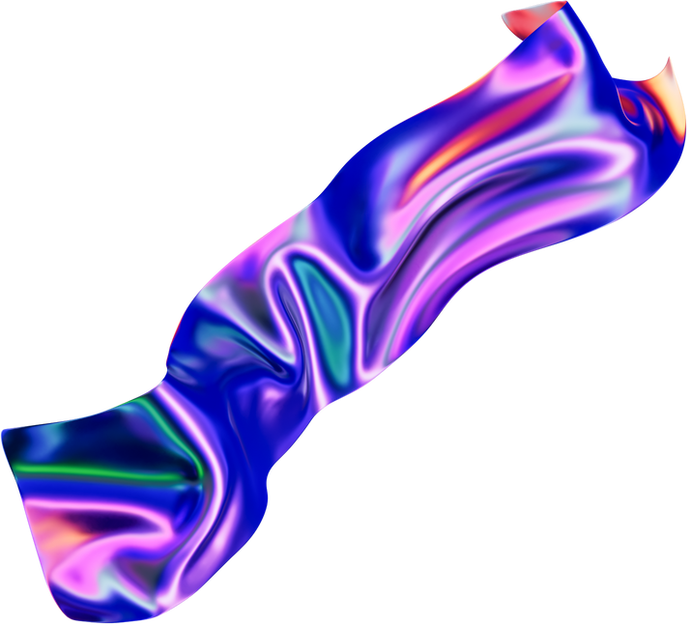


AI-powered Assistant integrated with Porter (n8n + LLM + MongoDB):
Real-time transcript analysis of doctor–patient conversations.
Summarizes patient responses clearly and concisely.
Extracts symptoms, conditions, lifestyle factors, family health history.
Suggests medically relevant follow-up questions.
Alerts doctors if patients show confusion or distress.

Slide 4
KEY FEATURES
🔹 Multi-language support (English, Hindi, regional languages).
🔹 Structured JSON output ready for underwriting.
🔹 Automated insertion into MongoDB for secure storage.
🔹 Top 3 real-time follow-up questions POSTed to doctors’ portal.
🔹 Context-aware memory across patient conversation turns.

Slide 5
WORKFLOW ARCHITECTURE
Patient transcript captured (Tele/Video MER).
AI Agent (Google Gemini + LangChain) processes transcript.
Structured output generated → MongoDB storage.
Follow-up questions POSTed via API to doctors in real time.
Insurance underwriters access complete, accurate MER.

Slide 6
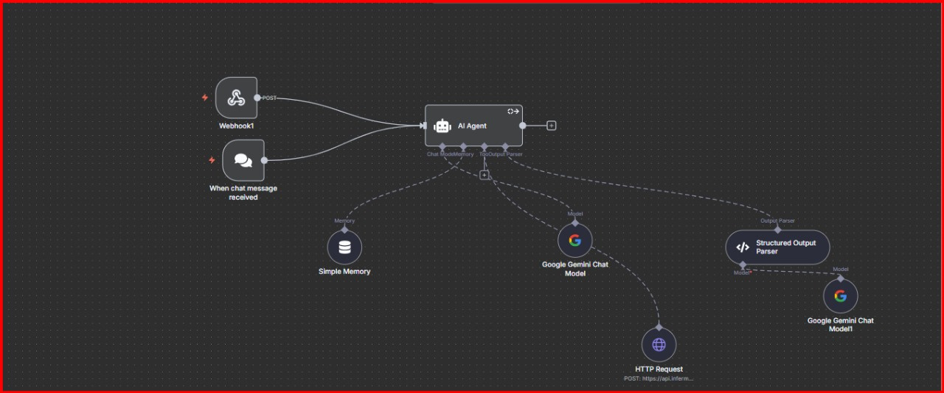

Slide 7
Benefits for ACKO
Aster & accurate MER processing.
Reduced underwriting delays.
Enhanced doctor productivity.
Better patient experience.
Scalable for millions of consultations.

